Slide 1
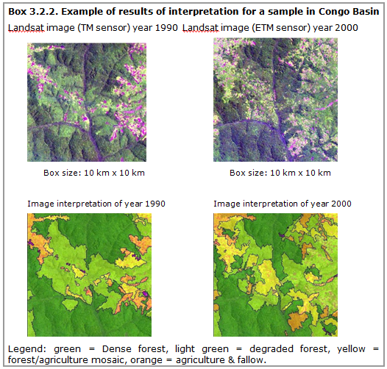



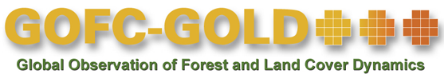
Module 2.1 Monitoring activity data for forests using remote sensing
Module developers:
Frédéric Achard, European Commission (EC) - Joint Research Centre (JRC)
Jukka Miettinen, EC - JRC
Brice Mora, Wageningen University
Yosio Shimabukuro, Instituto Nacional de Pesquisas Espaciais & EC - JRC
Country examples:
Brazil
India
Democratic Republic of the Congo
Source: GOFC-GOLD 2014, Bbox 3.2.2.
V1, May 2015
Creative Commons License

Slide 2
Country examples
The following slides will illustrate the main points of three different country-level approaches for forest-cover monitoring.
More details can be found in the Sourcebook (GOFC-GOLD 2014), section 3.2.
The country examples highlighted here include:
Brazil—PRODES deforestation monitoring program
India—Forest Survey of India (FSI)
Democratic Republic of the Congo (DRC)—JRC-FAO systematic sampling
Notes:
In the interest of illustrating some approaches selected for practical implementation of forest cover monitoring around the tropical countries, three country examples are presented in the following slides.
The examples are deliberately selected to include different kinds of approaches in order to highlight the variability of possibilities in the practical implementation of national level forest cover monitoring.
Three approaches implemented at national/regional level are highlighted:
1) The Brazilian forest monitoring system called PRODES, which produces annual wall-to-wall estimates of deforestation in the legal Amazon.
2) The Indian national biannual forest cover assessment, which produces biannual forest cover and deforestation maps
3) An example of JRC-FAO sampling based regional level deforestation monitoring approach in the Congo basin in Africa.
General sources:
Achard et al (2014);
Eva et al. 2010;
Government of Brazil 2014.

Slide 3
1. Brazil: PRODES monitoring program
The Brazilian National Institute for Space Research (INPE) assesses forest cover annually over the entire Brazilian Amazon (~5 million km²) in the PRODES monitoring program.
The first assessment was undertaken in 1978, and annual assessments have been conducted since 1988.
Landsat, DMC, and CBERS satellite data (20-30 meter resolution) acquired around August every year are used.
Open source software TerrAmazon by INPE is used for preprocessing and assimilation of remotely sensed data.
The mapping is performed by visual interpretation and manual digitization of deforested areas (MMU 6.25 hectares).
Spatially explicit results are published yearly around December and are available at http://www.obt.inpe.br/prodes.
Notes:
The Brazilian Amazon covers an area of approximately 5 million km², large enough to cover all of Western Europe. Around 4 million km² of the Brazilian Amazon is covered by forests. The Government of Brazil decided to generate periodic estimates of the extent and rate of gross deforestation in the Amazon. This task could never be conducted without the use of space technology.
The Brazilian National Institute for Space Research (INPE) produces annual estimates of deforestation in the legal Amazon from a comprehensive annual national monitoring program called PRODES. The first complete assessment by INPE was undertaken in 1978 using Landsat MSS images. Annual assessments have been conducted since 1988. For each assessment, up to 220 Landsat satellite images are acquired around August and analyzed. Results of the analysis of the satellite imagery are published every year. Spatially explicit results of the analysis are also publicly available. (See http://www.obt.inpe.br/prodes/.).
For best detail and so as to profit from the dry weather conditions of the summer for cloud-free satellite images, the interpretation is carried out once a year starting around August, with the release of preliminary estimates (based on critical areas) foreseen in December of that same year. The final results are published some time the following year.
PRODES also provides the spatial distribution of critical areas (in terms of deforestation) in the Amazon. As an example, for the period August 1, 2007 to August 1, 2008, more than 90% of the deforestation was concentrated in 87 of the 214 satellite images analyzed. PRODES uses imagery from TM (thematic mapper) sensors onboard Landsat satellites, sensors of DMC satellites, and CCD sensors (High Resolution CCD Cameras - charge-coupled devices) from CBERS satellites, with a spatial resolution between 20 and 30 meters.
PRODES has quantified approximately 752,000 km² of deforestation in the Brazilian Amazon through the year 2012, a total that accounts for approximately 19% of the original forest extent.
A new methodological approach based on digital image processing is now in the operational phase. The open source software TerrAmazon developed by INPE allows preprocessing and assimilation of remotely sensed data from multiple sources for monitoring deforestation. The system has multitasking capability and allows several users to operate simultaneously. The actual deforestation mapping is performed by visual interpretation and manual digitization of deforested areas with a minimum mapping unit (MMU) of 6.25 hectares.
PRODES has around 70 staff members, with a large part of them involved in the visual image analysis. A geo-referenced, multitemporal database is produced including a mosaic of deforested areas by states of the Brazilian federation. All results for the period 1997 to 2012 are accessible and can be downloaded from the INPE web site: http://www.obt.inpe.br/prodes/.
Notes: DMS = Disaster Monitoring Constellation CBERS = China-Brazil Earth Resources Satellite
Sources:
INPE 2008;
Shimabukuro et al. 2012;
Government of Brazil 2014.

Slide 4
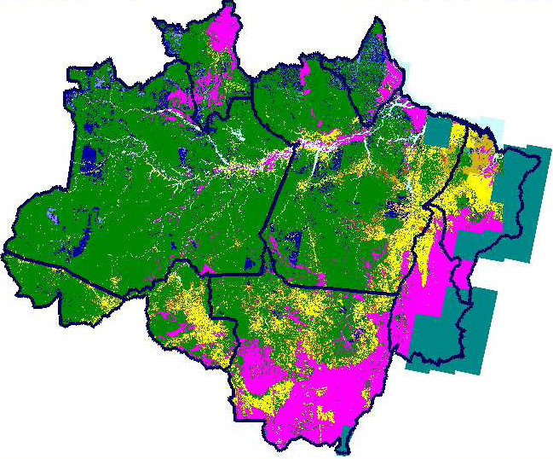
Brazil: PRODES yearly deforestation mapping
(~3,400 km x 2,200 km)
Green – Forest
Violet – non-forest
Yellow-Orange-Red – deforestation from 1997-2006
Landsat satellite mosaic of year 2006 and deforestation map period 1997–2006 of the entire Amazon in Brazil
Source: INPE, PRODES project, http://www.obt.inpe.br/prodes/.
Notes:
The slide presents an illustration of the PRODES system in use in Brazil for yearly deforestation mapping. The mapping is based on a mosaic of hundreds of Landsat and CBERS images (on the left). Deforestation mapping is performed using this mosaic, and a deforestation map covering the entire Amazon area is produced yearly. The image on the right illustrates the progress of deforestation from 1997 to 2006.
In the deforestation map on the right, forested areas appear in green, nonforest areas appear in violet, and the progression of deforestation 1997-2006 is shown in yellow-orange-red colours from oldest to newest.
The deforestation patterns of 1997–2006 are also overlaid on the Landsat mosaic.
Since May 2004, the Brazilian government also has in operation the DETER (Detecção de Desmatamento em Tempo Real) system to serve as an alert in almost real-time (every 15 days) for deforestation events larger than 25 hectares. The system uses MODIS data (spatial resolution 250 meters) and WFI data on board CBERS-2 (spatial resolution 260 meters) and a combination of linear spectral mixture modelling and visual analysis. Results are publicly available through http://www.obt.inpe.br/deter/.
In complement to its well-known deforestation monitoring system (PRODES) and its alert system (DETER), a new system has been used since 2007 to monitor forest area changes within forests (forest degradation), particularly burned area, named DEGRAD. Selective logging is the subject of another project, named DETEX. The demand for DEGRAD emerged after recent studies confirmed that logging damages annually an area as large as the area affected by deforestation in this region (i.e., 10,000 to 20,000 km²/year). The DEGRAD system supports the management and monitoring of large forest concession areas in the Brazilian Amazon. The DEGRAD system is based on the detection of degraded areas detected from the DETER alarm system. Likes PRODES, DEGRAD is using Landsat TM and CBERS data with a minimum mapping unit of 6.25 hectares. Degraded areas have been estimated for Brazilian Amazonia from year 2007 to year 2013 (http://www.obt.inpe.br/degrad/).

Slide 5
2. India: Forest Survey of India (FSI)
Remote sensing has been used in the biennial FSI since the early 1980s.
Currently, a 23.5 meter resolution IRS P6 satellite is used, with data acquired in October–December (to enable deciduous forest discrimination); minimum mapping unit is 1 hectare.
Unsupervised clustering followed by visual on-screen class assignment is used to produce the initial results.
Extensive six-month ground verification follows; necessary corrections (e.g., canopy density) are incorporated.
Extensive accuracy assessment using field plots and 6 meter resolution images (nearly 6,000 plots) is finally conducted.
The entire assessment cycle takes almost two years.
Notes:
The application of satellite remote sensing technology to assess the forest cover of the entire country in India began in early 1980s.
The National Remote Sensing Agency (NRSA) prepared the first forest map of the country in 1984 at 1:1 million scale by visual interpretation of Landsat data acquired at two periods: 1972–1975 and 1980–1982. The Forest Survey of India (FSI) has since been assessing the forest cover of the country on a two-year cycle. Over the years, there have been improvements both in the remote sensing data and the interpretation techniques.
The entire assessment from the procurement of satellite data to the reporting—including image rectification, interpretation, ground truthing (the interpretation of satellite imagery or for assessing the accuracy) and validation of the changes by the State/Province Forest Department—takes almost two years. Sourcebook (GOFC-GOLD 2014) table 3.2.1 shows details of the data, scale of interpretation, and methodology followed in wall-to-wall forest cover mapping done over a period of two decades in India.
The assessment uses satellite data from the Indian satellite IRS P6 (Sensor LISS-III at 23.5 m resolution) mostly from the period October–December, which is the most suitable period for Indian deciduous forests to be discriminated by satellite data. Satellite imagery with less than 10% cloud cover is selected for the 313 LISS-III scenes covering the Indian Territory. For a few cases (e.g., Lakshadweep where cloud free data for all islands were not available) the data period was extended up to March.
Satellite data are digitally processed, including radiometric and contrast corrections and geometric rectification (using geo-referenced topographic sheets at 1:50,000 scale from Survey of India). The interpretation involves a hybrid approach combining unsupervised classification in raster format and onscreen visual interpretation of classes. The Normalized Difference Vegetation Index (NDVI) is used for excluding nonvegetated areas. Finally, patches of less than 1 hectare of any land-cover class are removed by fusing them into the surrounding land cover.
The initial interpretation is then followed by extensive ground verification, which takes more than six months. All the necessary corrections are subsequently incorporated. Reference data collected by the interpreter during the field campaigns are used in the classification of the forest cover patches into canopy density classes. District and states/union territories forest cover maps are produced.
Accuracy assessment is an independent exercise. Randomly selected sample points are verified on the ground (field inventory data) or with satellite data at 5.8 meter resolution and compared with interpretation results. In the twelfth assessment, 5,729 points were distributed in a stratified random manner over the entire country. The overall accuracy level of the forest cover mapping for year 2006 (five forest classes) has been found to be 92%.

Slide 6
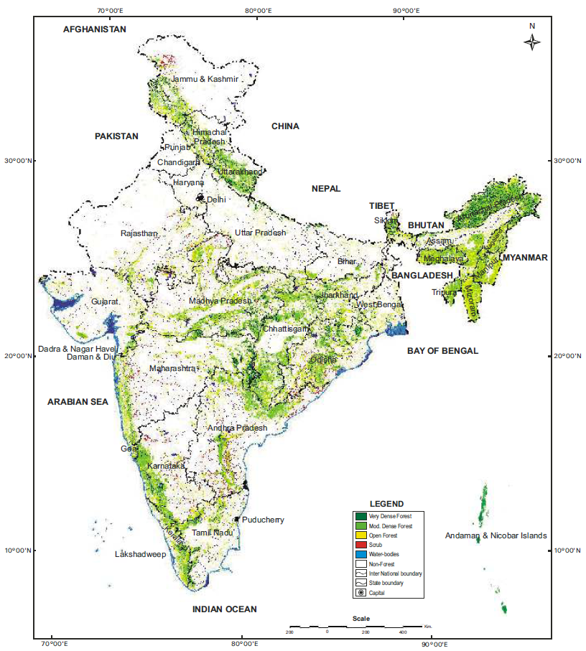

India: Forest cover map (1/2)
Forest cover map of India, 2013
Legend
Very dense forest
Mod dense forest
Open forest
Scrub
Source: Forest Survey of India website http://www.fsi.org.in/.
Notes:
The slide illustrates the results of the FSI. The final mapping results have a legend of five different classes, four of which apply to forest areas.
The map is derived from an Indian satellite, IRS-P6, with the use of two sensors: LISS III at 23.5 meter resolution and AWiFS at 56 meter resolution.
Source:
FSI 2013.

Slide 7
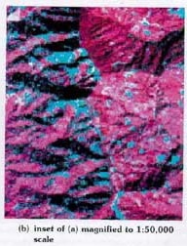
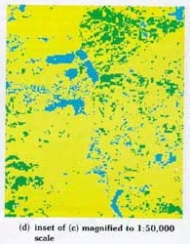
India: Forest cover map (2/2)
A detail of the forest cover map of India
Legend
Very dense forest
Mod dense forest
Open forest
Scrub
Non-forest
Source: Forest Survey of India website, http://www.fsi.org.in/
Notes:
The slide illustrates the results of the FSI in greater detail. The final mapping results have a legend of five different classes, four of which apply to forest areas.
The IRS satellite image is shown on the left and the classification result on the right. Patches of less than one hectare of any land-cover class are removed by fusing them into the surrounding land cover. Nevertheless, fine details and small patches of mapped forest can be seen in the classification example (right).
7

Slide 8
3. Democratic Republic of the Congo: JRC-FAO systematic sampling
A systematic sampling approach with 267 (20 × 20 km²) sampling sites distributed at every 0.5° was used.
30 meter resolution Landsat data for 1990, 2000, and 2005 was obtained for all sampling sites.
The satellite imagery was analyzed with an object-based (multidate segmentation) approach using land-cover signature database and subsequent visual validation.
The results are represented by a change matrix for every sample site and allow derivation of nationwide deforestation rate at high statistical accuracy (e.g., 2000–2005 annual deforestation rate 0.32% ± 0.05%).
Notes:
A regional exercise was carried out in Central Africa with the participation of international institutions and national experts under the framework of the Observatory for the Forests of Central Africa.
A systematic sampling approach using mid-resolution imagery (Landsat) was operationally applied to the entire Congo River Basin to accurately estimate deforestation at the regional level and, for large countries, at the national level for the period 1990 to 2005. The survey was composed of 20 × 20 km² sampling sites systematically distributed every 0.5° over the entire forest domain of Central Africa, corresponding to a sampling rate of 13.6% of the total area. This resulted in 547 sample sites over the Congo Basin, of which 267 were located in the DRC.
For each site, subsets were extracted from both Landsat TM and ETM+ imagery acquired in 1990, 2000, and 2005. The satellite imagery was analyzed with an object-based (multidate segmentation) approach using a land-cover signature database for classification, followed by visual validation.
The results are represented by a change matrix for every sample site, describing four regrouped land-cover change processes: deforestation, reforestation, forest degradation, and forest recovery. The samples in which a change in forest cover is observed are classified into 10 land-cover classes: (1) dense forest, (2) degraded forest, (3) long fallow and secondary forest, (4) forest/agriculture mosaic, (5) agriculture and short fallow, (6) bare soil and urban area, (7) nonforest vegetation, (8) forest-savannah mosaic, (9) water bodies, and (10) no data.
For a region like Central Africa, with 186 million hectares of forest cover, this exercise led to an estimate of the annual gross deforestation rate at 0.26 ± 0.04% for the period 2000–2005. For the DRC, which is covered by a large-enough number of samples (267), the estimated annual deforestation rate was 0.32 ± 0.05%. Degradation rates were also estimated (gross annual rate: 0.14 ± 0.02 % for the entire basin).
Sources:
de Wasseige 2012;
Ernst et al. 2012.;
Potapov et al. 2012.

Slide 9
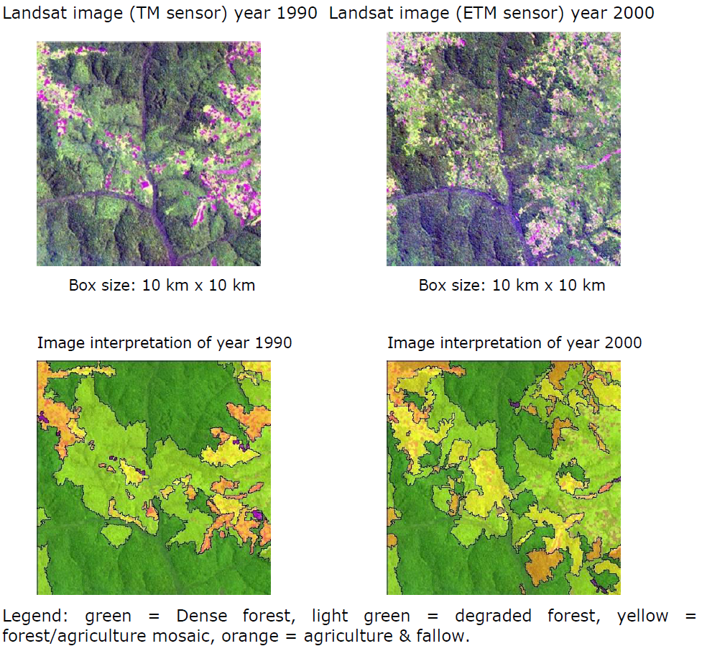
Defining degraded forest
Example of results of interpretation for a sample in Congo Basin
Source: Sourcebook (GOFC-GOLD 2014), box 3.2.2.
Notes:
Degraded forest was defined spectrally from the imagery (lighter tones in image color composites as compared to dense forests).

Slide 10
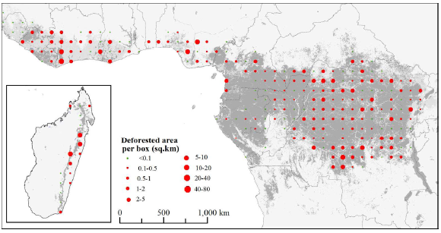
Democratic Republic of the Congo: Deforestation results
DRC
Source: Mayaux et al. 2013.
Notes:
The slide presents deforestation results based on a systematic sampling scheme in the central part of Africa. Each dot represents a sampling site where deforestation has been detected. The size of the dot is correlated to the extent of deforestation. Note that although this type of systematic sampling scheme cannot be used to produce wall-to-wall maps of forest cover, it can be used to derive deforestation statistics on national and regional levels (as long as the number of plots allows statistically meaningful estimation).
Source:
Mayaux et al. 2013.

Slide 11
Recommended modules as follow-up
Module 2.2 to proceed with monitoring activity data for forests remaining forests (including forest degradation)
Module 2.8 for overview and status of evolving technologies, including, e.g., radar data
Module 3 to learn more about REDD+ assessment and reporting

Slide 12
References
Achard, F., Beuchle, R., Mayaux, P., Stibig, H.-J., Bodart, C., Brink, A., Carboni, S., Desclée. B., Donnay, F., Eva, H.D., Lupi, A., Raši, R., Seliger, R. and Simonetti, D., 2014. “Determination of Tropical Deforestation Rates and Related Carbon Losses from 1990 to 2010.” Global Change Biology 20: 2540–2554.
de Wasseige, C., P. de Marcken, N. Bayol, F. Hiol, Ph. Mayaux, B. Desclée, R. Nasi, A. Billand, P. Defourny, and R. Eba’a Atyi, eds. 2012. The Forests of the Congo Basin: State of the Forest 2010. Luxembourg: Publication Office of the European Commission. https://ec.europa.eu/jrc/sites/default/files/lbna25161enc_002.pdf
Ernst, C., A. Verhegghen, P. Mayaux, M. Hansen, and P. Defourny .2012. Central Africa Forest Cover and Forest Cover Change Mapping. In de Wasseige et al., eds., The Forests of the Congo Basin: State of the Forest 2010, 23–41.
Eva, H., Carboni, S., Achard, F., Stach, N., Durieux, L., Faure, J-F. and Mollicone, D., 2010. “Monitoring Forest Areas from Continental to Territorial Levels Using a Sample of Medium Spatial Resolution Satellite Imagery.” ISPRS J. Photogram. Remote Sensing, 65: 191–197.
FSI (Forestry Survey of India). 2013. State of Forest Report 2013. Dehradun, India: Forest Survey of India. http://fsi.nic.in/cover_2013/message_content_preface3.pdf.

Slide 13
GOFC-GOLD (Global Observation of Forest Cover and Land Dynamics). 2014. A Sourcebook of Methods and Procedures for Monitoring and Reporting Anthropogenic Greenhouse Gas Emissions and Removals Associated with Deforestation, Gains and Losses of Carbon Stocks in Forests Remaining Forests, and Forestation. (Often GOFC-GOLD Sourcebook.) Netherland: GOFC-GOLD Land Cover Project Office, Wageningen University. http://www.gofcgold.wur.nl/redd/index.php.
Government of Brazil. 2014. Brazil’s Submission of a Forest Reference Emission Level for Deforestation in the Amazonia Biome for Results-based Payments for REDD+ under the UNFCCC. Brasília. http://unfccc.int/methods/redd/items/8414.php.
INPE (National Institute for Space Research). 2008. Monitoramento da cobertura florestal da Amazônia por satélites: Sistemas PRODES, DETER, DEGRAD e QUEIMADAS 2007–2008. Brasília. http://www.obt.inpe.br/prodes/index.html.
Mayaux, P., Pekel, J-F., Desclée, B., Donnay, F., Lupi, A., Achard, F., Clerici, M., Bodart, C., Brink, A., Nasi, R., and Belward, A., 2013. “State and Evolution of the African Rainforests between 1990 and 2010.” Philosophical Transactions of the Royal Society B 368 (1625): 20120300. http://dx.doi.org/10.1098/rstb.2012.0300.
Potapov, P. V., S. A. Turubanova, M.C. Hansen, B. Adusei, M. Broich, A. Altstatt, L. Mane, C. O. Justice. 2012. “Quantifying Forest Cover Loss in Democratic Republic of the Congo, 2000–2010, with Landsat ETM+ Data.” Remote Sensing of Environment 122: 106–116.

Slide 14
Shimabukuro, Y. E., J. R. dos Santos, A. R. Formaggio, V. Duarte, B. F. T. Rudorff. 2012. “The Brazilian Amazon Monitoring Program.” In Global Forest Monitoring from Earth Observation, edited by F. Achard and M. C. Hansen, 167–184. Boca Raton, FL: CRC Press.

